Slide 1




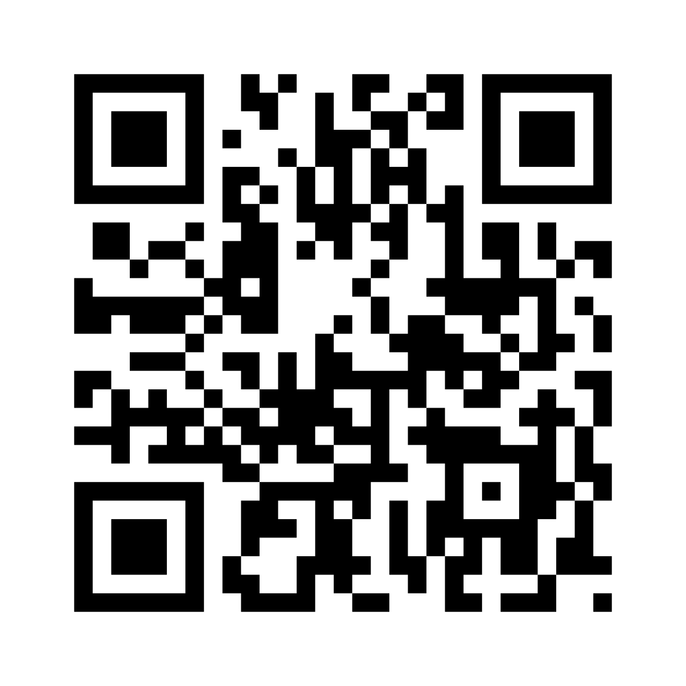

Attendance By QrCode
Applied By:
Asaf Ben Shabat
Avichai Aziz
Project leader:
Dr. Iyad Suleiman

Slide 2
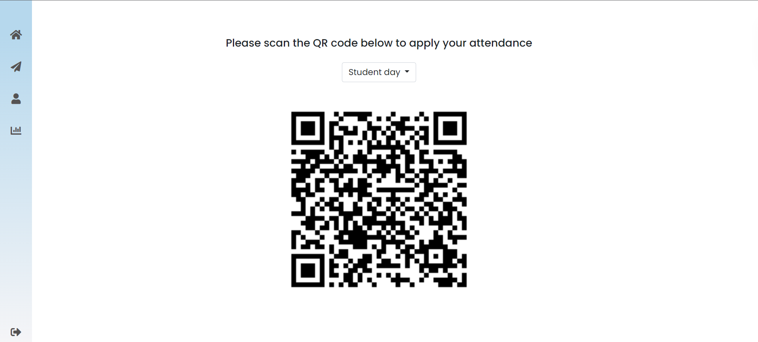
Our Goal
Provide organizations with a web application that simplifies attendance tracking and absenteeism management, aims to streamline the process by utilizing QR codes for accurate attendance recording.

Slide 3
Achievements
Easy to use & Saves Time - Scanning QR code to approve attendance, real-time updates, email notifications, Docker support for easy deployment.
Secure authentication - Using JWT (Json Web Tokens) for login.
Ensure attendance - The app includes features such as Google Maps integration for location verification.
Allow reporting - Shows graph with the attendance and the absenteeism.
Overall, the app's objective is to enhance organizational efficiency and communication by providing a comprehensive attendance tracking solution.

Slide 4




Used Technologies
Dotnet 7: Using for backend server along with data control ORM – Entity Framework.
Angular 14: For client interface.
SignalR: For server-client communication on real-time.
SMTP server: Used for sending email notifications.
SQL Server: Data storage solution.
JWT (JSON Web Tokens): Secure authentication method.
Google Maps API: Integration for location verification.
Docker: Containerization and deployment support.

Slide 5
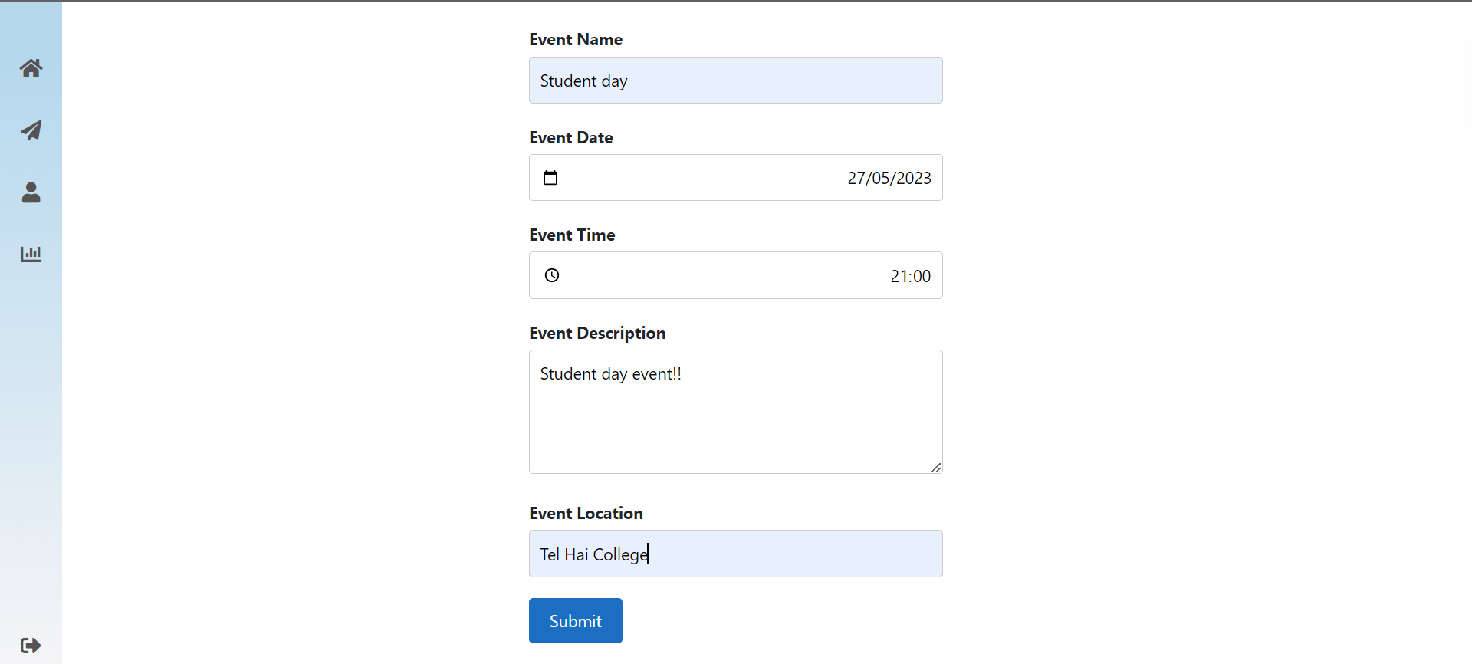
Our mainly features
Users Can:
Create events by specifying the date, time, and location using Google Maps integration, ensuring accurate event details.

Slide 6
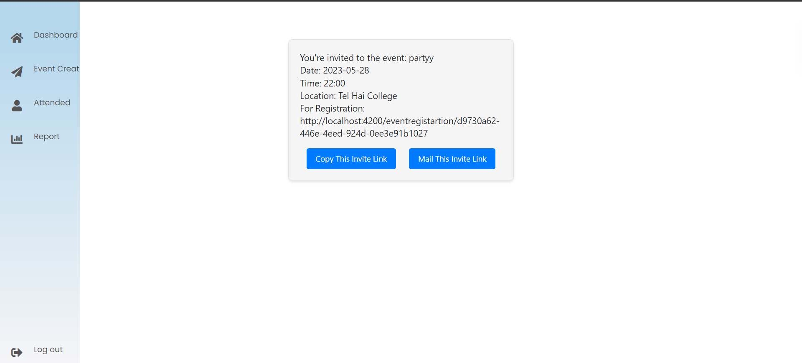
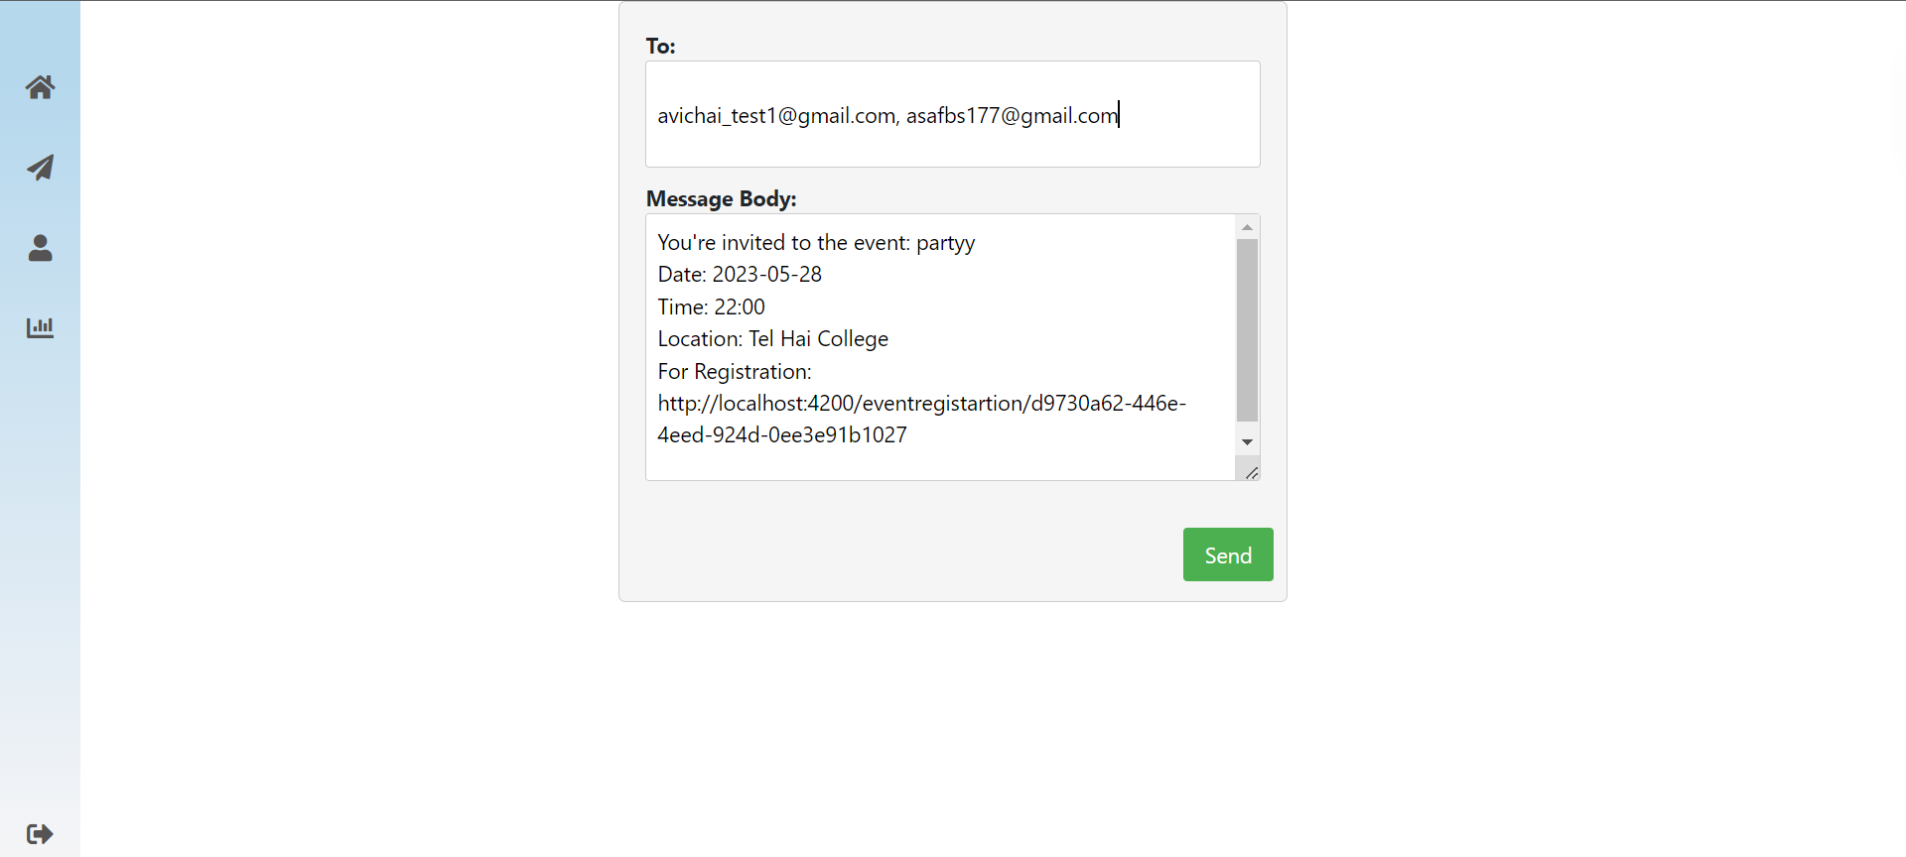
Our mainly features
As an event creator, easily send email notifications to attendees before and after the event, ensuring effective communication and updates.

Slide 7
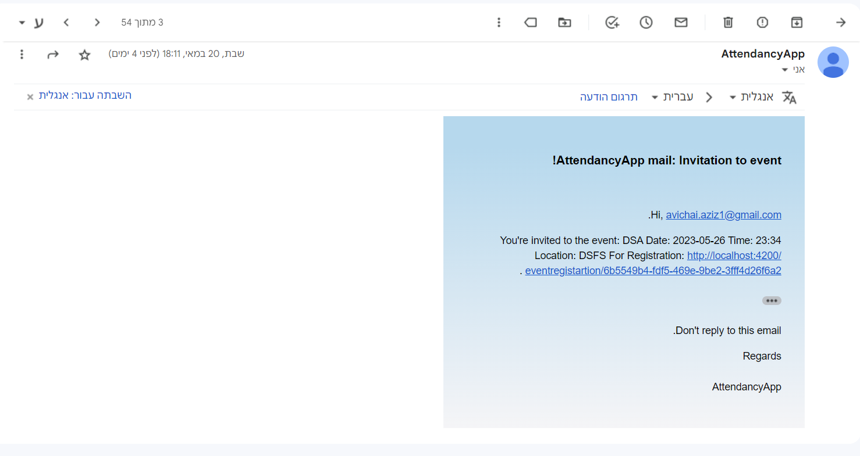
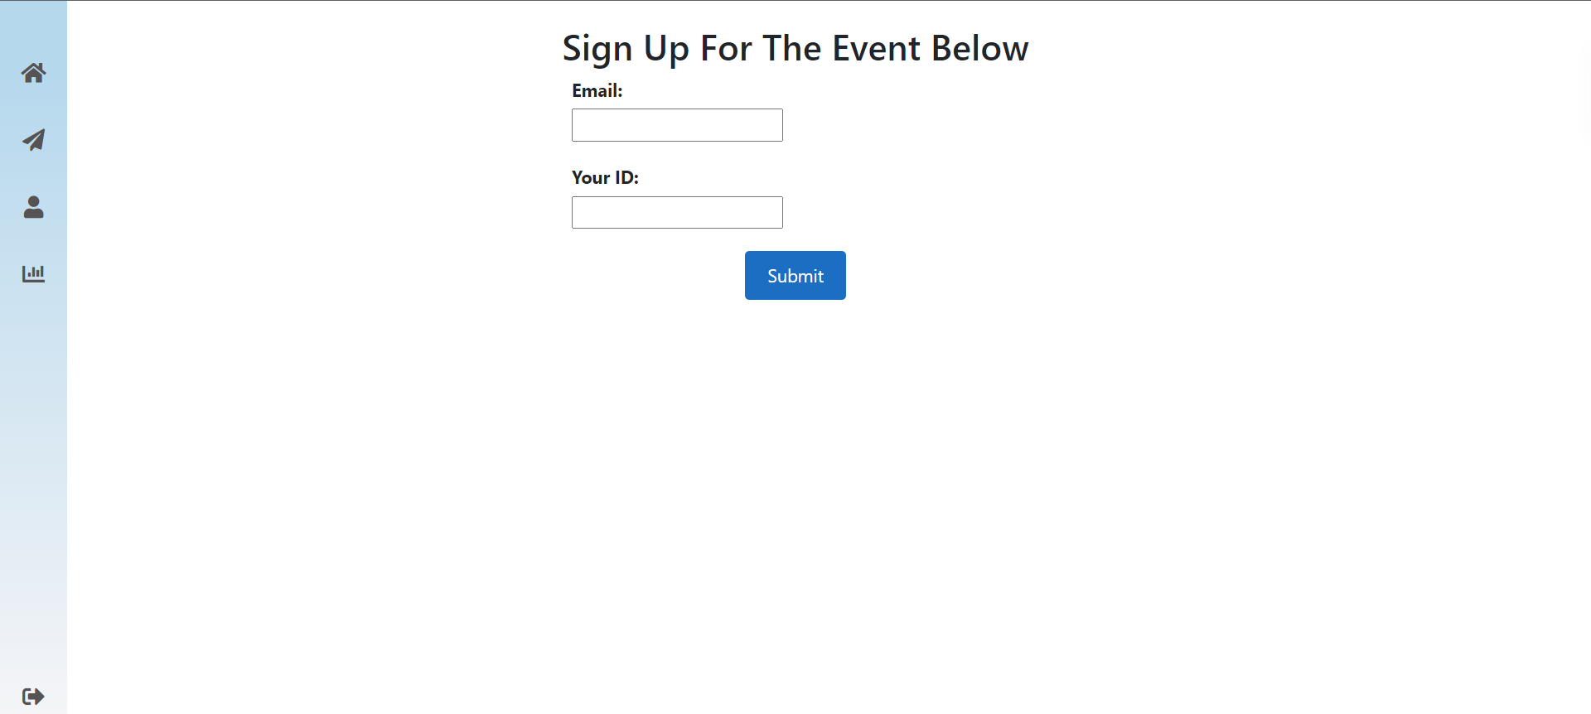
Our mainly features
Attendees can conveniently sign themselves in using the invitation received via email, simplifying the attendance process.

Slide 8
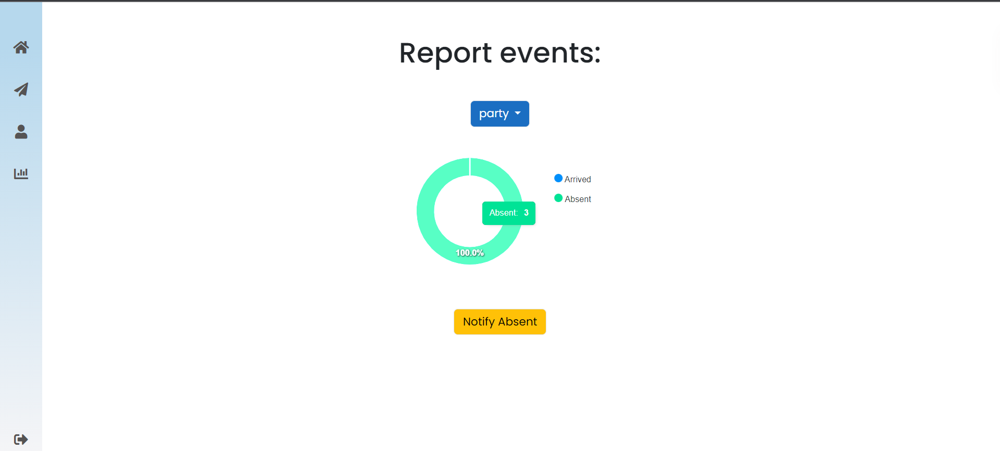
Our mainly features
Event creators can generate comprehensive reports indicating the list of attendees who participated in the event and those who were absent, facilitating efficient tracking and analysis.

Slide 9
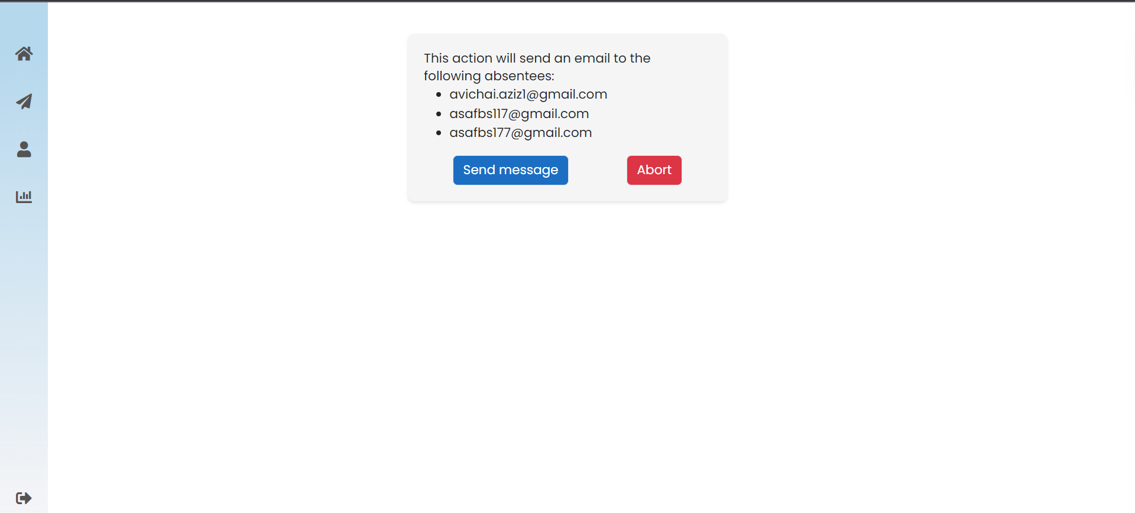
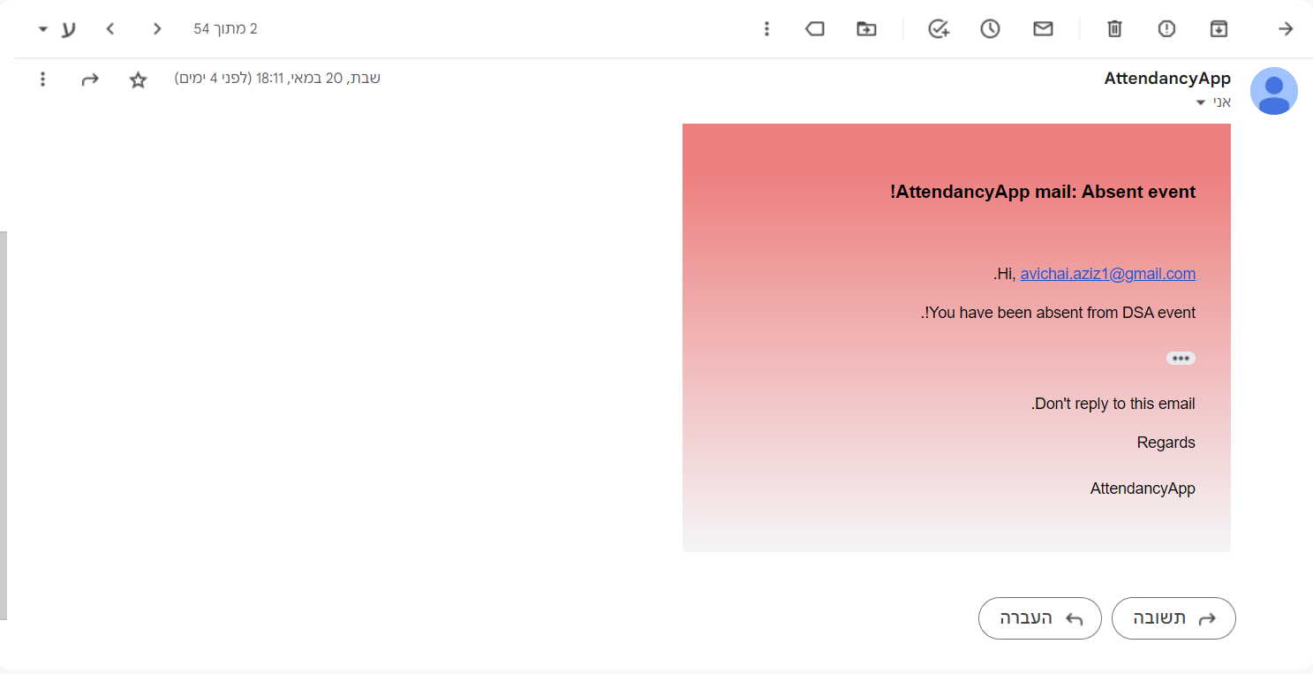
Our mainly features
Sending emails to all the attendees that absent from the event.

Slide 10
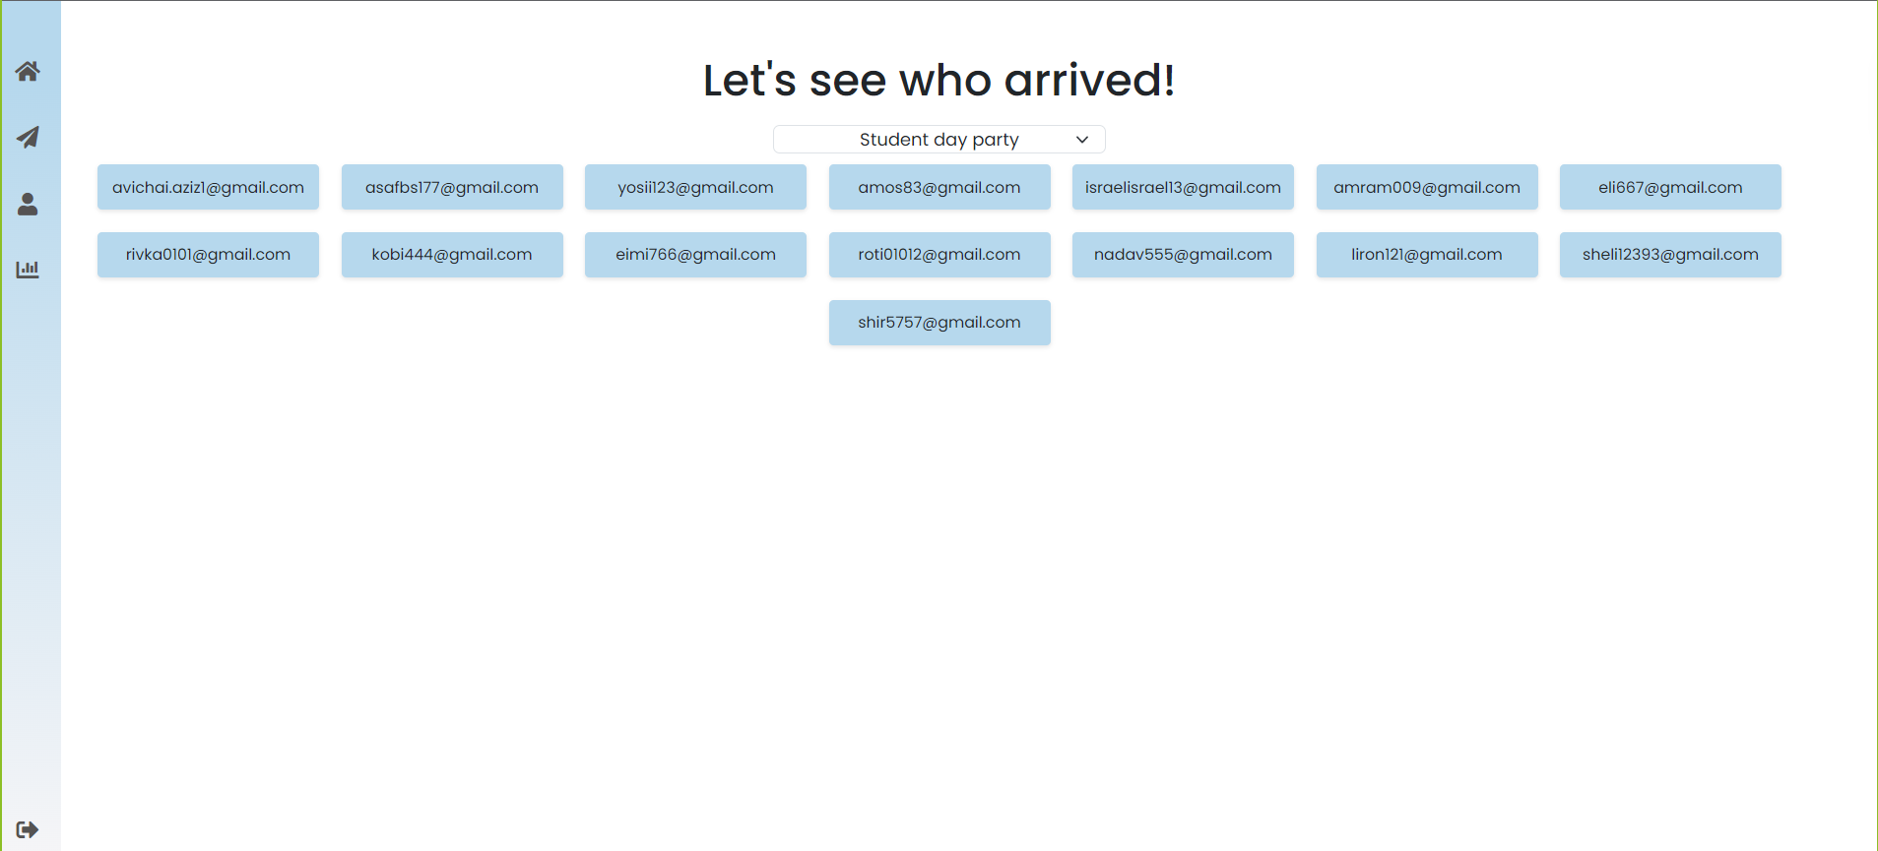
Our mainly features
Users will receive real-time updates and notifications through a user-friendly interface, ensuring that event creators and attendees stay informed about any important updates or changes related to the event, enhancing overall user experience and engagement.

Slide 11
Google maps geolocation api
By integrating the Google Maps API into the Attendance-Track app, we ensure that the QR code scanner is restricted to the specific event area.
This adds an extra layer of validation and security, as attendees must be physically present at the designated location to successfully scan their QR codes.
The Google Maps API integration enhances the precision and reliability of attendance tracking, providing organizers with accurate and verified data.

Slide 12
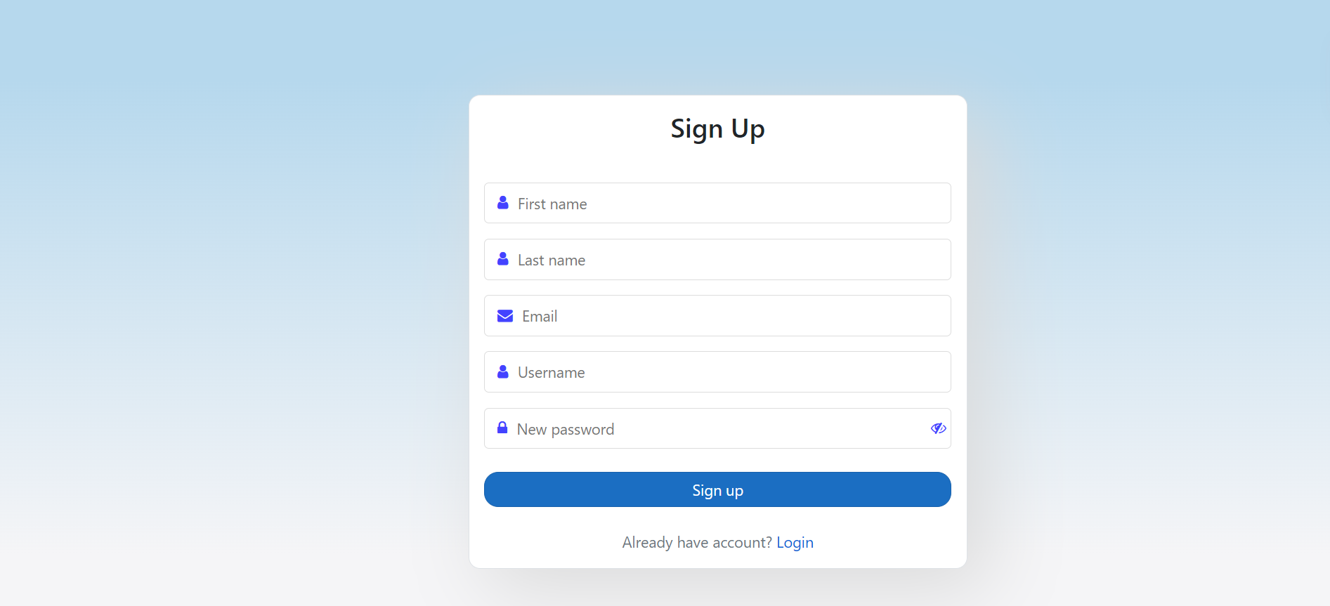
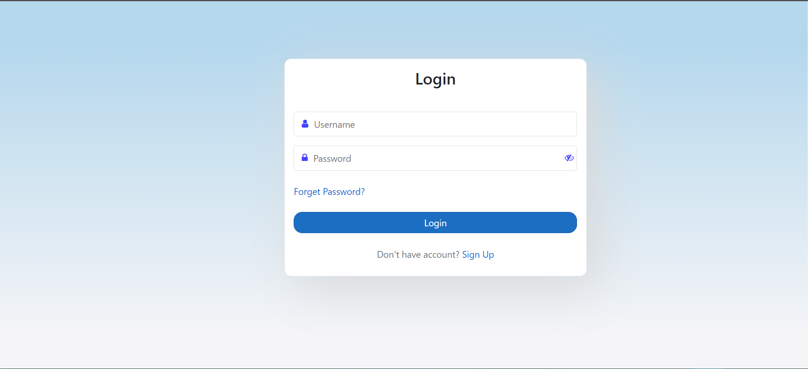
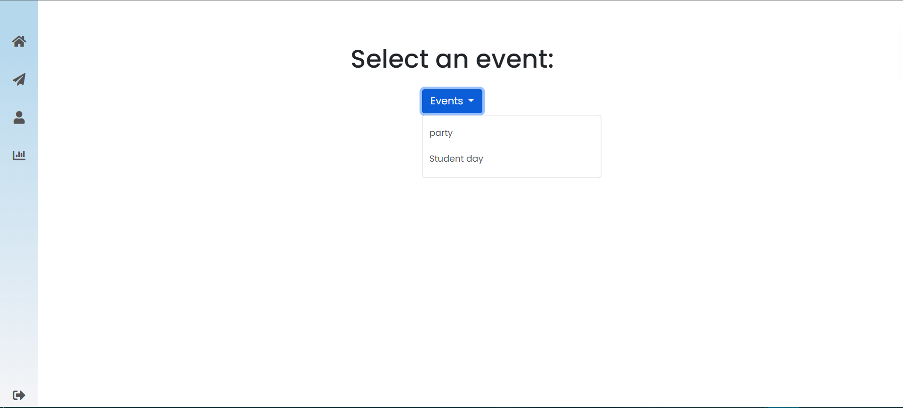
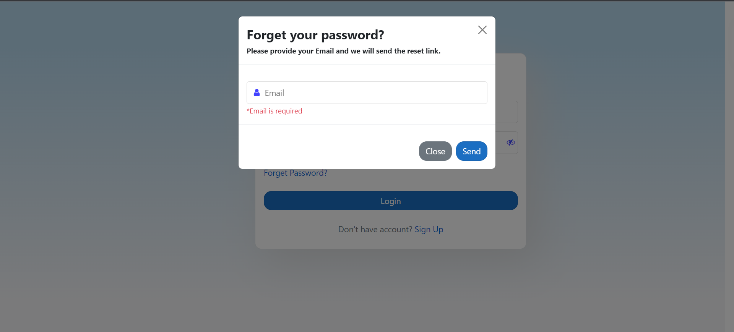
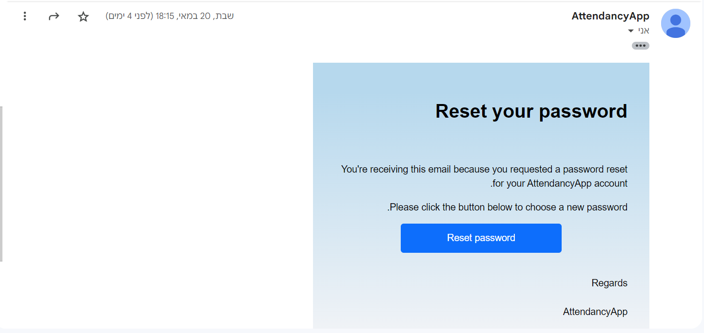
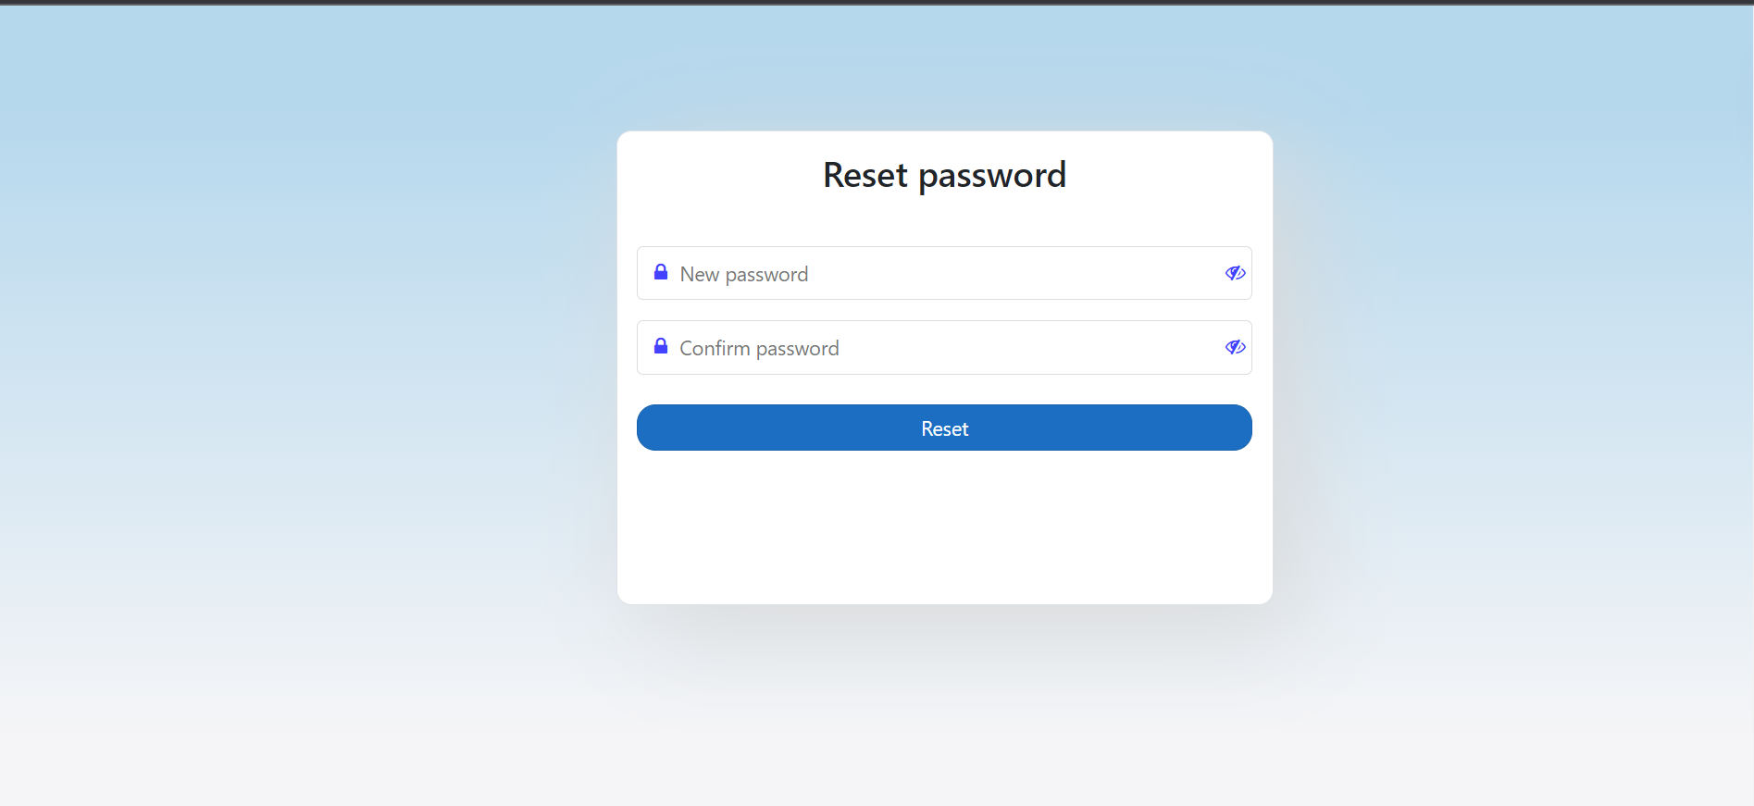
A Small taste from our ui

Slide 13
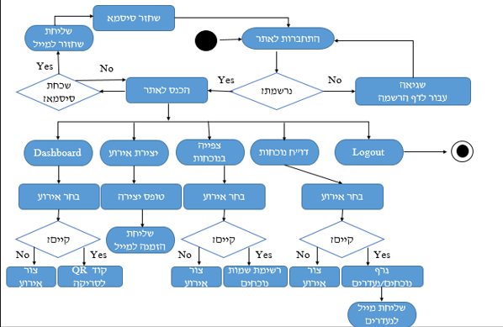
Activity Diagram

Slide 14
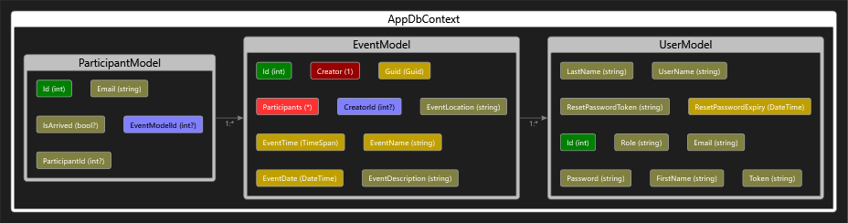
Model View Diagram

Slide 15

Testing the app under high traffic
Python Locust library - For conducting high-traffic load testing on our Dotnet controllers, to ensure the performance and scalability of the Attendance -Track app.
By simulating thousands of concurrent users, Locust allowed us to assess the app's ability to handle heavy workloads and identify any potential bottlenecks or performance issues.
This testing approach provided valuable insights into the app's responsiveness and helped optimize the Dotnet controllers for optimal performance under real-world usage scenarios.

Slide 16

Thank For Listening

